Slide 1
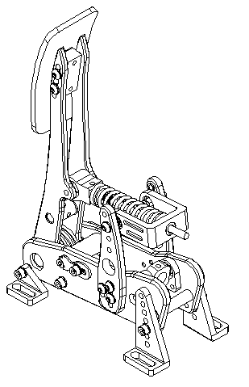
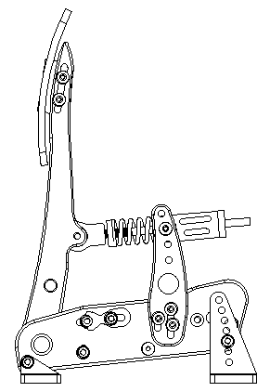
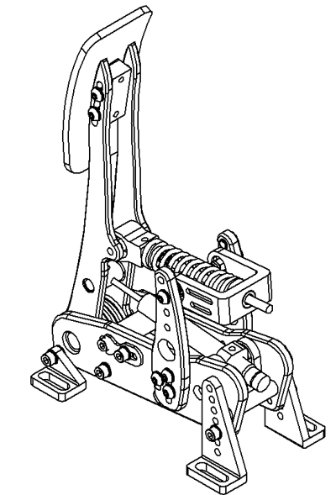
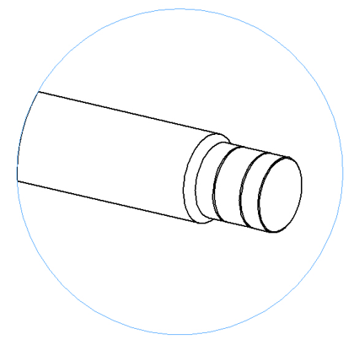
Adjust pedal unit angle
Adjust travel range
Select the suitable angle. The manufacture provides 7 angle adjustment holes to set your pedal angle. Tighten the bolts to secure the angle brackets to the Clutch unit.
Step 1: Twist the spring cap to a high position
Step 2: Loosen the 2 bolts on the sides and move the bottom blue bump stop up or down, find your preferred recline angle then tighten the bolts
Step 3: Loosen the 4 bolts on both sides and move the top blue bump stop forward or backward to find your preferred pedal travel range.
Remove the two bolts and 4 washers
12º
9º
6º
3º
0º
-3º
-6º
Adjust the height of the pedal face
Adjust spring tension
Adjust damper levels
Loosen the 4 screws on the sides behind the pedal face
Twist the end of the damper unit so that the white dot lines up with a number. 1 being the easiest to depress the pedal and 8 being the hardest to depress the pedal
Choose a suitable pedal height, then tighten the bolts.
Twist the spring tension adjustment cap further to the front to reduce spring tension and further to the back to increase spring tension
3
4
2
1

